Slide 1
CSE 12 Week 8 Discussion
5-21-21
Focus: Exam 2 Review

Slide 2
Reminders
PA7 (closed) due Tuesday, May 26th @ 11:59 PM
PA5 Resubmission due TODAY @ 11:59 PM
PA6 Resubmission due Friday, May 28th @ 11:59 PM

Slide 3
Questions?

Slide 4
Midterm 2 Concepts
Time Complexities
Sorting
Maps and HashTables
Focus on PAs, lecture, and Quizzes

Slide 5
Go over Review Slides?
Yes
No

Slide 6
Runtime Analysis

Slide 7
Common Time Complexities in Order
ordering of functions from slowest-growing (indeed, the first two shrink as n increases) to fastest-growing that you might find helpful:
f(n) = 1/(n^2)
f(n) = 1/n
f(n) = 1
f(n) = log(n)
f(n) = sqrt(n)
f(n) = n
f(n) = n^2
f(n) = n^3
f(n) = n^4
… and so on for constant polynomials …
f(n) = 2^n
f(n) = n!
f(n) = n^n

Slide 8
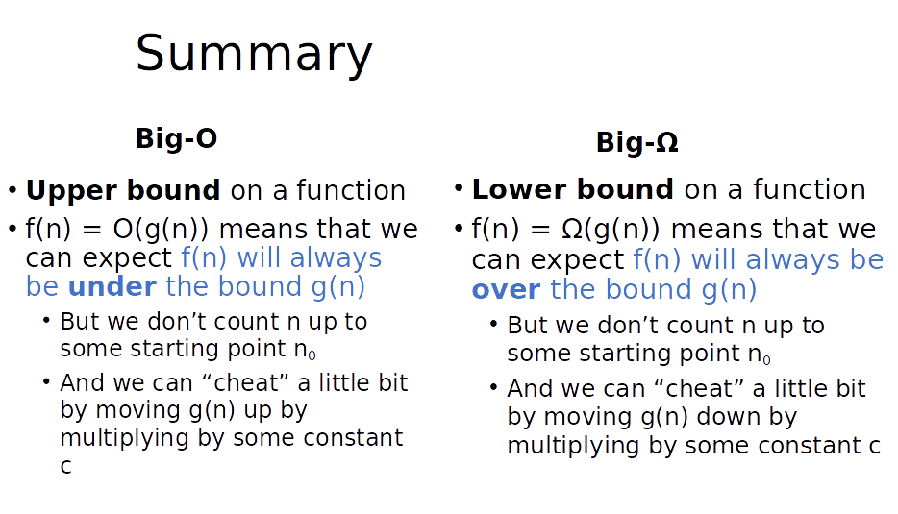

Slide 9
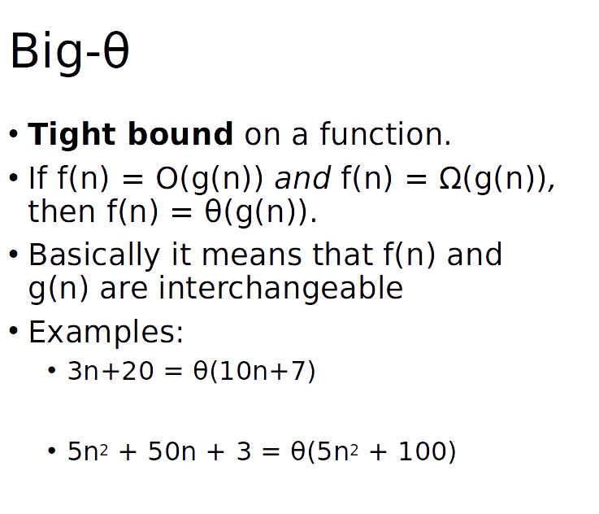

Slide 10
Review Question
Which is the upper bound in this statement? g(n) = O(f(n))

Slide 11
Review Question
Which is the upper bound in this statement? g(n) = Ω(f(n))

Slide 12
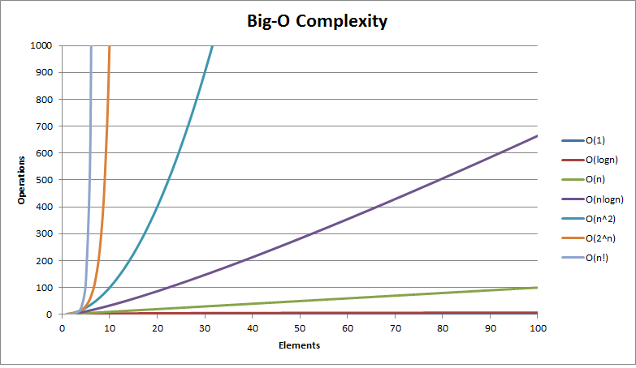
Big-O review
Relative to input n
Constants do not matter
O(3n)=O(n)
Higher order values dominate
O(n^2 + n) = O(n^2)

Slide 13
True or False?
n + 5n^3 + 8n^4 = O(n)
True
False

Slide 14
True or False?
n + 5n^3 + 8n^4 = O(n)
True
False

Slide 15
True or False?
n! + n^2 = O(nlog(n))
True
False

Slide 16
True or False?
n! + n^2 = O(nlog(n))
True
False

Slide 17
True or False?
2^n + nlog(n) = O(n!)
True
False

Slide 18
True or False?
2^n + nlog(n) = O(n!)
True
False

Slide 19
Sorting

Slide 20
Sorting Algorithms
Selection Sort: finds the minimum element in a list and moves it to the end of a sorted prefix in the list
Insertion Sort: repeatedly takes the next element in a list, inserts it into the correct ordered position within a sorted prefix of the list
Quicksort: picks an element as pivot and partitions the given array around the picked pivot
Merge sort: recursively sorts half of the array

Slide 21
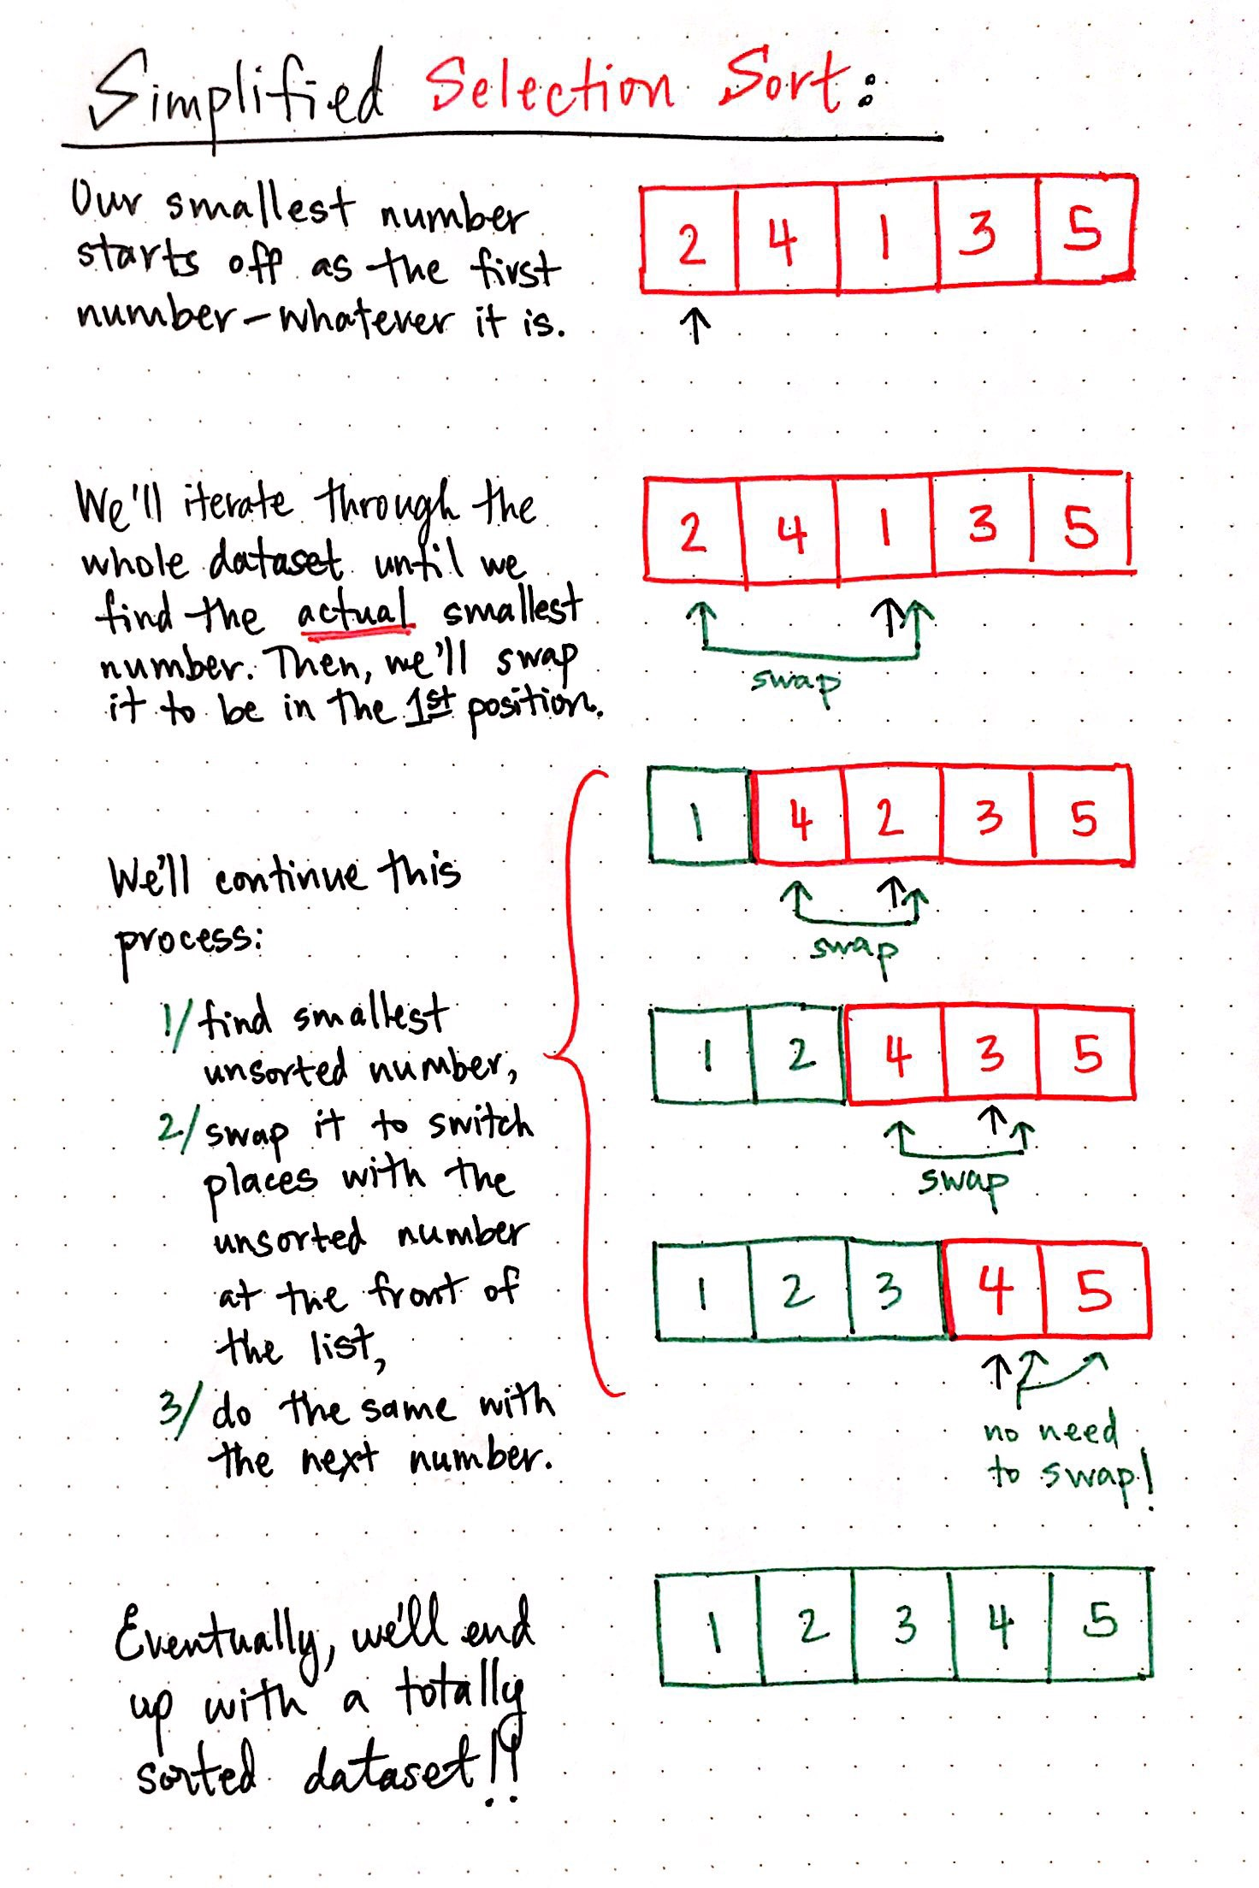
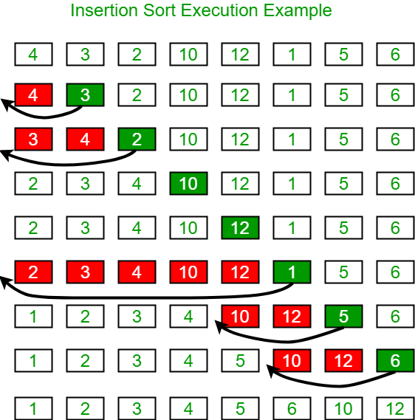

Slide 22
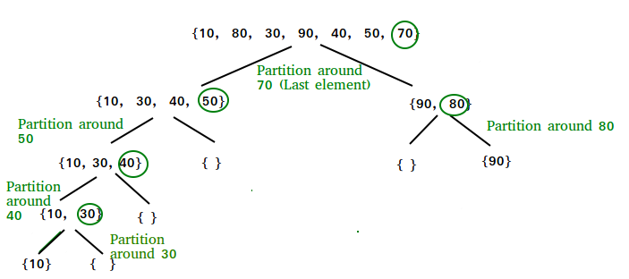

Slide 23
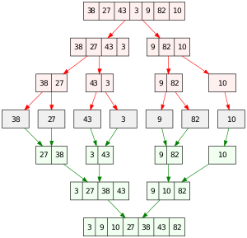

Slide 24
What is a partition in quicksort?
Partitioning is a component in quicksort and an algorithm that is called again and again until the original array elements are sorted as single-element arrays
A pivot index is selected (for example, pick the last element), then the array is partitioned in such a way that the input array has its elements moved around so that element values less than or equal to the pivot index’s value are to the left of the pivot index and element values greater than or equal to the pivot index’s value are to the right
Note: the array is not necessarily completely sorted here (and probably isn’t)!
Now the array is divided into two at the point where the pivot index ended up
Partition is called on each of these two subarrays using the “same” pivot point location (we picked the last element and do so again for each of these subarrays)
We partition again, and this process is repeated until we have single-element arrays that are sorted between themselves; see visualization in next slide

Slide 25

Graphic visualization of quicksort
Resultant single-element arrays to combine: {{10}, {30}, {40}, {50}, {70}, {80}, {90}}

Slide 26
Review Quiz Questions
Which of the following will result in the most number of element comparisons using selection sort? Select all that apply:
{1, 2, 3, 4, 5}
{5, 4, 3, 2, 1}
{1, 3, 5, 2, 4}
{1, 4, 5, 3, 2}
{1, 1, 1, 1, 1}

Slide 27
Review Quiz Questions
Which of the following will result in the most number of element comparisons using selection sort? Select all that apply:
{1, 2, 3, 4, 5}
{5, 4, 3, 2, 1}
{1, 3, 5, 2, 4}
{1, 4, 5, 3, 2}
{1, 1, 1, 1, 1}
All of them!

Slide 28
Which of the following descriptions of pivot selection will result in the best case quicksort runtime?
Randomly choosing the pivot
Choosing the first value as the pivot
Choosing the median index as the pivot
Choosing the median value as the pivot
There is no definite pivot selection method that will always result in best case runtime

Slide 29
Which of the following descriptions of pivot selection will result in the best case quicksort runtime?
Randomly choosing the pivot
Choosing the first value as the pivot
Choosing the median index as the pivot
Choosing the median value as the pivot
There is no definite pivot selection method that will always result in best case runtime

Slide 30
Maps and HashTables

Slide 31
Maps
Assign a key to each value we are trying to keep track of.
Key 1 ---> Some value a
Key 2 ---> Some value b
Key 3 ---> Some value c
etc...

Slide 32
Map<K,V> Interface
Implemented in Java by AbstractMap, HashMap, TreeMap etc.
Index for entry is determined by a hash function that calculates index using key value (useful for quick lookup and insert)
Contains methods get(Object key), put(K key, V value), size(), replace(K key, V value) etc.
Keys need to be unique
Existing data structures we can use to implement this - ArrayList!

Slide 33
Hash Functions
int hash1(String s) {
return s.length();
}
int hash2(String s) {
int hash = 0;
for(int i = 0; i < s.length(); i += 1) {
hash += Character.codePointAt(s, i);
}
return hash;
}
public int hash3(String s) {
int h = 0;
for (int i = 0; i < s.length(); i++) {
h = 31 * h + Character.codePointAt(s, i);
}
return h;
}

Slide 34
int hash(char key) {
return (int) key;
}
Which of the following sequences of insertions would cause the most collisions for a hash table with four buckets and assuming expandCapacity is not called during the adds?
add('A', 56); add('B', 5); add('C', 65); add('D', 2);
add('E', 43); add('F', 7); add('K', 6); add('L', 160);
add('M', 58); add('Q', 14); add('U', 20); add('W', 37);
add('N', 7); add('R', 24); add('V', 92); add('Z', 100);
add('Z', 91); add('R', 604); add('P', 9); add('L', 5);

Slide 35
int hash(char key) {
return (int) key;
}
Which of the following sequences of insertions would cause the most collisions for a hash table with four buckets and assuming expandCapacity is not called during the adds?
add('A', 56); add('B', 5); add('C', 65); add('D', 2);
add('E', 43); add('F', 7); add('K', 6); add('L', 160);
add('M', 58); add('Q', 14); add('U', 20); add('W', 37);
add('N', 7); add('R', 24); add('V', 92); add('Z', 100);
add('Z', 91); add('R', 604); add('P', 9); add('L', 5);

Slide 36
int hash(String key) {
return key.length;
}
/*
----------
| |
| -
| |
----------
| |
| - {"greetings" : 6}
| |
----------
| |
| - {"hi" : 5}
| |
----------
| |
| - {"bye" : 9}
| |
----------
| |
| - {"happy week 7" : 3}
| |
----------
| |
| - {"hello" : 2}
| |
----------
| |
| -
| |
----------
| |
| -
| |
----------
*/
After expandCapacity is called, which of the following elements will have a different index in the new array after rehashing?
{"greetings" : 6}
{"hi" : 5}
{"bye" : 9}
{"happy week 7" : 3}
{"hello" : 2}

Slide 37
int hash(String key) {
return key.length;
}
/*
----------
| |
| -
| |
----------
| |
| - {"greetings" : 6}
| |
----------
| |
| - {"hi" : 5}
| |
----------
| |
| - {"bye" : 9}
| |
----------
| |
| - {"happy week 7" : 3}
| |
----------
| |
| - {"hello" : 2}
| |
----------
| |
| -
| |
----------
| |
| -
| |
----------
*/
After expandCapacity is called, which of the following elements will have a different index in the new array after rehashing?
{"greetings" : 6}
{"hi" : 5}
{"bye" : 9}
{"happy week 7" : 3}
{"hello" : 2}

